Slide 1
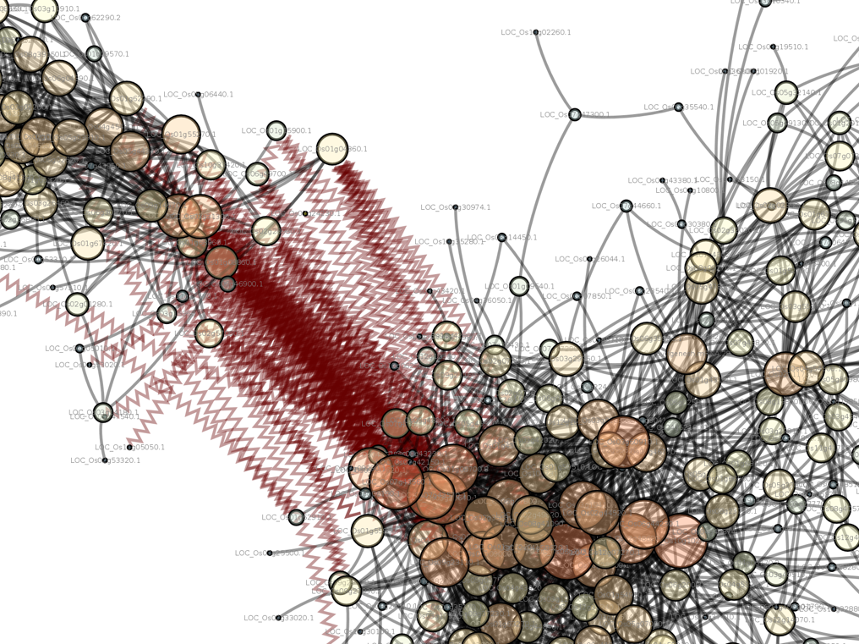
Introduction to Computing for Data Science
Day 13
02/20/2018
Hort 503-01 Spring 2018

Slide 2
Question and Answer Session
Now is the time to ask any questions you may have had concerning the first lesson and assignment.

Slide 3
Assignment #7 Review
Reading in a CSV with Pandas (ign.csv form tutorial)?
Anything unexpected about that input file?
What is different from how Panda’s load vs Numpy?
import pandas as pd
reviews = pd.read_csv("ign.csv")
,score_phrase,title,url,platform,score,genre,editors_choice,release_year,release_month,release_day
0,Amazing,LittleBigPlanet PS Vita,/games/littlebigplanet-vita/vita-98907,PlayStation Vita,9.0,Platformer,Y,2012,9,12
1,Amazing,LittleBigPlanet PS Vita -- Marvel Super Hero Edition,/games/littlebigplanet-ps-vita-marvel-super-hero-edition/vita-20027059,PlayStation Vita,9.0,Platformer,Y,2012,9,12
2,Great,Splice: Tree of Life,/games/splice/ipad-141070,iPad,8.5,Puzzle,N,2012,9,12
3,Great,NHL 13,/games/nhl-13/xbox-360-128182,Xbox 360,8.5,Sports,N,2012,9,11

Slide 4
Assignment #7 Review
Why open a file using Pandas rather than Numpy?

Slide 5
Assignment #7 Review
Why open a file using Pandas rather than Numpy?
  Pandas automatically puts the file into a DataFrame object.
  Pandas supports files with different data types in each column.

Slide 6
Assignment #7 Review
What do these three code samples do?
  These code samples use the video game review data from the tutorial.
reviews.iloc[:,1]
reviews.loc[:,"score_phrase"]
reviews["score"]
They all select the “score” column and return a DataSeries object.
How can you get both ‘score’ and ‘release_year’ at the same time?
,score_phrase,title,url,platform,score,genre,editors_choice,release_year,release_month,release_day
0,Amazing,LittleBigPlanet PS Vita,/games/littlebigplanet-vita/vita-98907,PlayStation Vita,9.0,Platformer,Y,2012,9,12
1,Amazing,LittleBigPlanet PS Vita -- Marvel Super Hero Edition,/games/littlebigplanet-ps-vita-marvel-super-hero-edition/vita-20027059,PlayStation Vita,9.0,Platformer,Y,2012,9,12
2,Great,Splice: Tree of Life,/games/splice/ipad-141070,iPad,8.5,Puzzle,N,2012,9,12
3,Great,NHL 13,/games/nhl-13/xbox-360-128182,Xbox 360,8.5,Sports,N,2012,9,11

Slide 7
Assignment #7 Review
What do these three code samples do?
  These code samples use the video game review data from the tutorial.
reviews.iloc[:,1]
reviews.loc[:,"score_phrase"]
reviews["score"]
They all select the “score” column and return a DataSeries object.
How can you get both ‘score’ and ‘release_year’ at the same time?
reviews[["score", "release_year"]]
,score_phrase,title,url,platform,score,genre,editors_choice,release_year,release_month,release_day
0,Amazing,LittleBigPlanet PS Vita,/games/littlebigplanet-vita/vita-98907,PlayStation Vita,9.0,Platformer,Y,2012,9,12
1,Amazing,LittleBigPlanet PS Vita -- Marvel Super Hero Edition,/games/littlebigplanet-ps-vita-marvel-super-hero-edition/vita-20027059,PlayStation Vita,9.0,Platformer,Y,2012,9,12
2,Great,Splice: Tree of Life,/games/splice/ipad-141070,iPad,8.5,Puzzle,N,2012,9,12
3,Great,NHL 13,/games/nhl-13/xbox-360-128182,Xbox 360,8.5,Sports,N,2012,9,11

Slide 8

Assignment #7 Review
The tutorial called iloc and loc functions…. But they don’t look like function calls….
reviews.iloc[5:10, 1]
Q: Where are the parenthesis?

Slide 9
Assignment #7 Review
The tutorial called iloc and loc functions…. But they don’t look like function calls….
reviews.iloc[5:10, 1]
Q: Where are the parenthesis?
A: It’s python Magic….
Python uses a hidden __get_item__ function that allows you to use an “indexer” on a class. The square brackets [] are shortcut to tell python to use this function. iloc is really a class, so we’re calling iloc.__getitem__() when we use reviews.iloc[] to index data in the frame.
This is what happens behind the scenes:
reviews.iloc.__getitem__((slice(5,10,1), slice(1)))

Slide 10
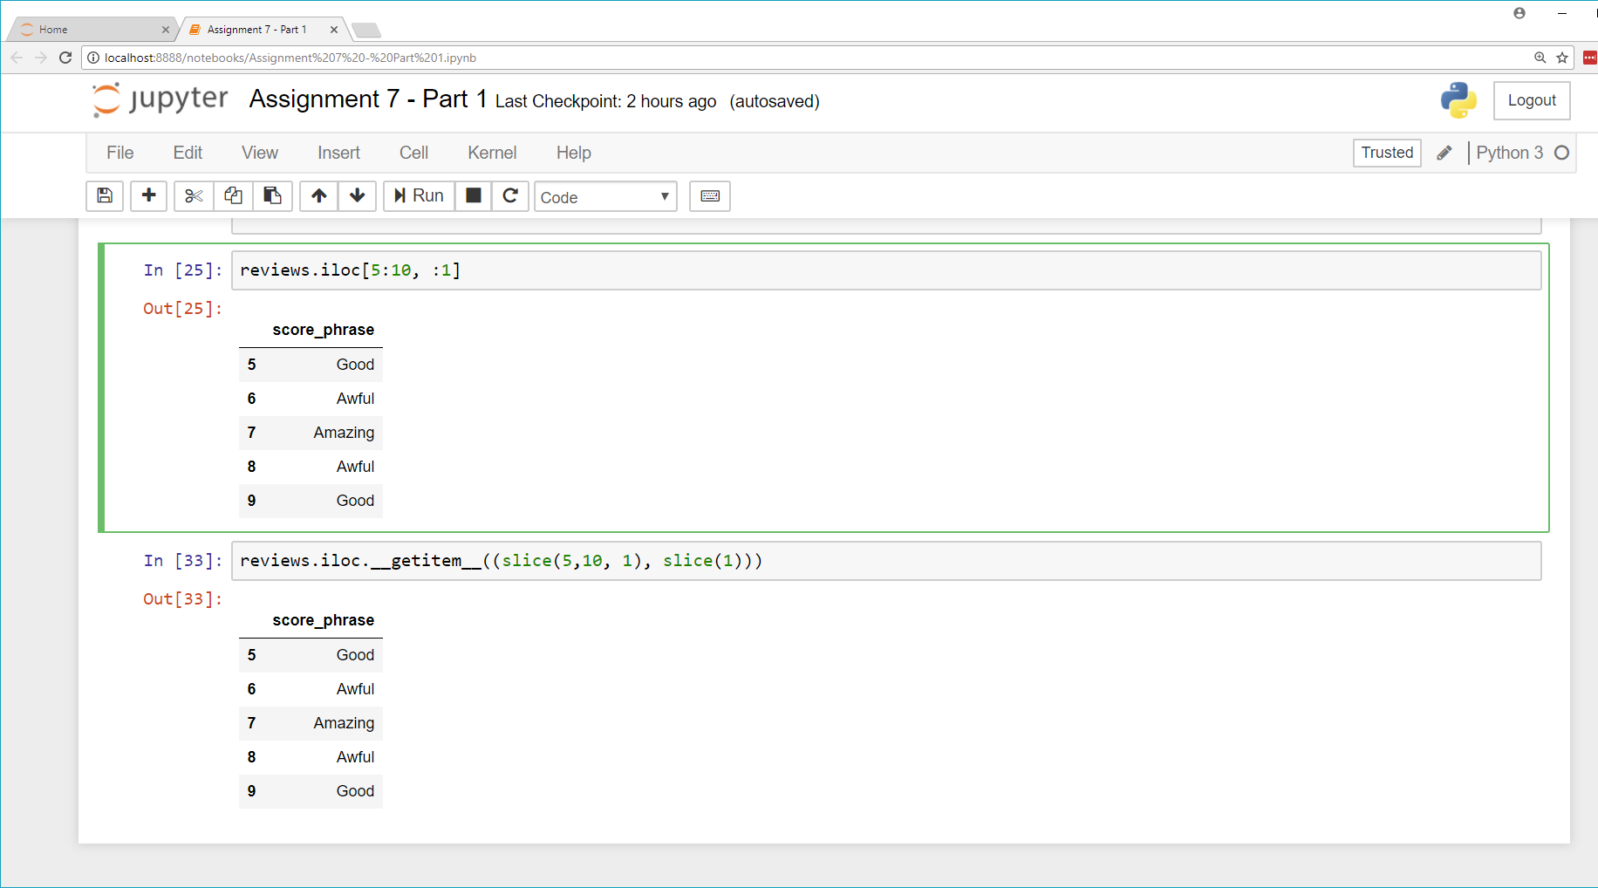
Assignment #7 Review
Which do you prefer?
Exhibit A
Exhibit B

Slide 11
Assignment #7 Review
How would you create a data frame with the following content:
Kid | Won’t Eat | Will Eat
Haylie | Rice | Sushi
Emily | Cheese | Rice
Annie | Chicken Nuggets | Sushi
Justin | Sushi | Chicken Nuggets

Slide 12
Assignment #7 Review
How would you create a data frame with the following content:
lunch_challenge = pd.DataFrame({
'Kid': ['Haylie', 'Emily', 'Annie', 'Justin'],
'Won\'t Eat': ['Rice', 'Cheese', 'Chicken Nuggets', 'Sushi'],
'Will Eat': ['Sushi', 'Rice', 'Sushi', 'Chicken Nuggets']
})
Kid | Won’t Eat | Will Eat
Haylie | Rice | Sushi
Emily | Cheese | Rice
Annie | Chicken Nuggets | Sushi
Justin | Sushi | Chicken Nuggets

Slide 13
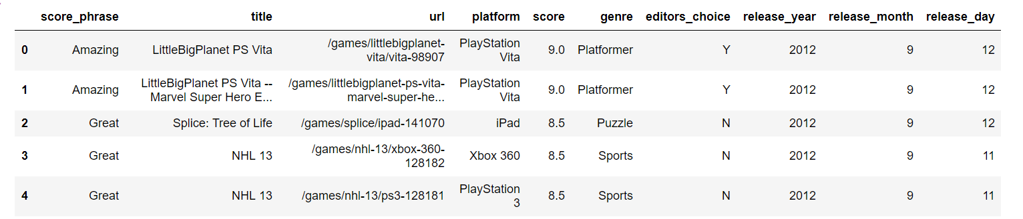
Assignment #7 Review
Can someone explain what this code is doing?
score_filter = review['score'] > 7
filtered_reviews = reviews[score_filter]
filtered_reivews.head()
Results:

Slide 14
Assignment #7 Review
Can someone explain what this code is doing?
score_filter = review['score'] > 7
filtered_reviews = reviews[score_filter]
filtered_reivews.head()
Results:
This returns a Boolean Series. That is then used to index. Remember, we did this with Numpy?

Slide 15
Assignment #7 Review
Wait a minute….
The following line makes sense. We were told we could get an entire column (i.e. Series) by just using it’s name:
score_filter = reviews["score"] > 7
But what about this:
score_filter = reviews["score"] > 7
filtered_reviews = reviews[score_filter]

Slide 16
Assignment #7 Review
Wait a minute….
The following line makes sense. We were told we could get an entire column (i.e. Series) by just using it’s name:
score_filter = reviews["score"] > 7
But what about this:
score_filter = reviews["score"] > 7
filtered_reviews = reviews[score_filter]
Rember the __getitem__ magic? The DataFrame class has it too! It lets us pull out an index, or specify a Boolean series to get rows.

Slide 17
Assignment #7 Review
Explain what this code does?
import math
def gender_code(gender_string):
if isinstance(gender_string, float) and math.isnan(gender_string):
return gender_string
return int(gender_string == "Female")
data["gender"] = data["What is your gender?"].apply(gender_code)
data["gender"].value_counts(dropna=False)
Results:
1.0 544
0.0 481
NaN 33
Name: gender, dtype: int64

Slide 18
Assignment #7 Review
Explain what this code does?
import math
def gender_code(gender_string):
if isinstance(gender_string, float) and math.isnan(gender_string):
return gender_string
return int(gender_string == "Female")
data["gender"] = data["What is your gender?"].apply(gender_code)
data["gender"].value_counts(dropna=False)
Results:
1.0 544
0.0 481
NaN 33
Name: gender, dtype: int64
Counts our new values that replaced the gender strings.
This apply is called on a Series. If this were a DataFrame object then the entire row would be passed in.
Why would we want convert male and female to a 0 and 1?

Slide 19
Assignment #7 Review
Explain what this code does?
import math
def gender_code(gender_string):
if isinstance(gender_string, float) and math.isnan(gender_string):
return gender_string
return int(gender_string == "Female")
data["gender"] = data["What is your gender?"].apply(gender_code)
data["gender"].value_counts(dropna=False)
Results:
1.0 544
0.0 481
NaN 33
Name: gender, dtype: int64
Counts our new values that replaced the gender strings.
This apply is called on a Series. If this were a DataFrame object then the entire row would be passed in.
Why would we want convert male and female to a 0 and 1?
One example: regression analysis, nominal data must be converted to integers

Slide 20
Assignment #7 Review
The tutorial stated this: “In the below example, we check the data type of each column in data using a lambda function.”
Then gave this code:
data.apply(lambda x: x.dtype).head()
What is a “lambda function”?

Slide 21
Assignment #7 Review
The tutorial stated this: “In the below example, we check the data type of each column in data using a lambda function.”
Then gave this code:
data.apply(lambda x: x.dtype).head()
What is a “lambda function”?
It is an anonymous function. It’s used in place and doesn’t need a def declaration.
def p2(x):
return x**2
g = p2(8)
print g(8)
64
This actually helps keep your code clean—you don’t need little functions all over for simply apply operations.
These do the same thing
g = lambda x: x**2
print g(8)
64

Slide 22
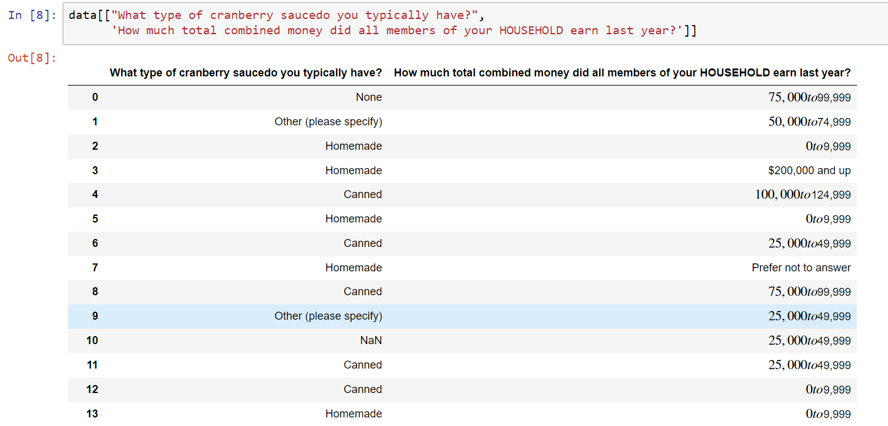
Assignment #7 Review
What would the following code to do the data frame below?
  grouped = data.groupby("What type of cranberry saucedo you typically have?")

Slide 23
Assignment #7 Review
What would the following code to do the data frame below?
  grouped = data.groupby("What type of cranberry saucedo you typically have?")
Grouping by the “type of cranberry sauce” will create a DataFrameGroupBy
Where each element is a list of indexes for each type.

Slide 24
Assignment #7 Review
grouped = data.groupby("What type of cranberry saucedo you typically have?")
grouped.groups
{'Canned': Int64Index([ 4, 6, 8, 11, 12, 15, 18, 19, 26, 27,
...
1040, 1041, 1042, 1044, 1045, 1046, 1047, 1051, 1054, 1057],
dtype='int64', length=502),
'Homemade': Int64Index([ 2, 3, 5, 7, 13, 14, 16, 20, 21, 23,
...
1016, 1017, 1025, 1027, 1030, 1034, 1048, 1049, 1053, 1056],
dtype='int64', length=301),
'None': Int64Index([ 0, 17, 24, 29, 34, 36, 40, 47, 49, 51,
...
980, 981, 997, 1015, 1018, 1031, 1037, 1043, 1050, 1055],
dtype='int64', length=146),
'Other (please specify)': Int64Index([ 1, 9, 154, 216, 221, 233, 249, 265, 301, 336, 380,
435, 444, 447, 513, 550, 749, 750, 784, 807, 860, 872,
905, 1000, 1007],
dtype='int64')}
What are these numbers?

Slide 25
Assignment #7 Review
grouped = data.groupby("What type of cranberry saucedo you typically have?")
grouped.groups
{'Canned': Int64Index([ 4, 6, 8, 11, 12, 15, 18, 19, 26, 27,
...
1040, 1041, 1042, 1044, 1045, 1046, 1047, 1051, 1054, 1057],
dtype='int64', length=502),
'Homemade': Int64Index([ 2, 3, 5, 7, 13, 14, 16, 20, 21, 23,
...
1016, 1017, 1025, 1027, 1030, 1034, 1048, 1049, 1053, 1056],
dtype='int64', length=301),
'None': Int64Index([ 0, 17, 24, 29, 34, 36, 40, 47, 49, 51,
...
980, 981, 997, 1015, 1018, 1031, 1037, 1043, 1050, 1055],
dtype='int64', length=146),
'Other (please specify)': Int64Index([ 1, 9, 154, 216, 221, 233, 249, 265, 301, 336, 380,
435, 444, 447, 513, 550, 749, 750, 784, 807, 860, 872,
905, 1000, 1007],
dtype='int64')}
What are these numbers?
These are the indexes of the rows that are in the group.
Compare these indexes to the “Homemade” items two slides before this one

Slide 26
Assignment #7 Review
What is “grouped” set to?
grouped = data.groupby("What type of cranberry saucedo you typically have?")
What is “group_income” set to?
group_income = grouped["income"]

Slide 27
Assignment #7 Review
What is “grouped” set to?
grouped = data.groupby("What type of cranberry saucedo you typically have?")
A DataFrameGroupBy object.
What is “group_income” set to?
group_income = grouped["income"]
A SeriesGroupBy object.
  Instead of containing a data frame per element it contains a series per element
  Each element is the “income” column from the original data frame
  Each element is a subset of the original data frame using the origin group by criteria.

Slide 28
Assignment #7 Review
grouped = data.groupby("What type of cranberry saucedo you typically have?")
for name, group in grouped:
print(name)
print(group.shape)
print(type(group))
Here we’re looping over the grouped DataFrameGroupBy object. This doesn’t look like anything we’ve seen before. How is this possible?

Slide 29
Assignment #7 Review
grouped = data.groupby("What type of cranberry saucedo you typically have?")
for name, group in grouped:
print(name)
print(group.shape)
print(type(group))
More Python Magic!
Classes can implement an
iterator function that returns an
iterator object.
x = grouped.__iter__()
You cycle through elements of
the using the __next__ function.
x.__next__()
Here we’re looping over the grouped DataFrameGroupBy object. This doesn’t look like anything we’ve seen before. How is this possible?
These do the same thing
x = grouped.__iter__()
while True:
try:
name, group = x.__next__()
print(name)
print(group.shape)
print(type(group))
except StopIteration:
break

Slide 30
Assignment #7 Review
Concatenate by adding rows and matching on columns:
pd.concat(df1, df2)
( , ) = ?
Concatenating by adding columns and matchings on rows:
pd.concat(df1, df2, axis=1)
( , , axis=1) = ?

Slide 31
Assignment #7 Review
Concatenate by adding rows and matching on columns:
pd.concat(df1, df2)
( , ) =
Concatenating by adding columns and matchings on rows:
pd.concat(df1, df2, axis=1)
( , , axis=1) =
 |  |  |  |  | *
 |  |  |  |  | *
 |  |  |  | *
 |  |  |  | *
Columns are sorted alphanumerically and * indicates missing value

Slide 32
Assignment #7 Review
What is an inner join?
What is a left inner join?
What is a right inner join?
What is an outer join?

Slide 33

Assignment #7 Review
What is an inner join?
What is a left inner join?
What is a right inner join?
What is an outer join?

Slide 34
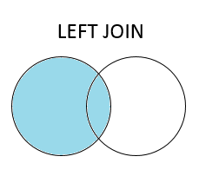
Assignment #7 Review
What is an inner join?
What is a left inner join?
What is a right inner join?
What is an outer join?

Slide 35
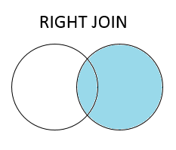
Assignment #7 Review
What is an inner join?
What is a left inner join?
What is a right inner join?
What is an outer join?

Slide 36

Assignment #7 Review
What is an inner join?
What is a left inner join?
What is a right inner join?
What is an outer join?

Slide 37
Assignment #7 Review
What happens if you perform an inner join, left join, right join, outer join on these two data sets? (top table is left table, bottom is right)
OrderID | CustomerID | EmployeeID | OrderDate | ShipperID
10308 | 2 | 7 | 1996-09-18 | 3
10309 | 37 | 3 | 1996-09-19 | 1
10310 | 77 | 8 | 1996-09-20 | 2
CustomerID | CustomerName | ContactName | Address | City | PostalCode | Country
1 | Alfreds Futterkiste | Maria Anders | Obere Str. 57 | Berlin | 12209 | Germany
2 | Ana Trujillo Emparedados y helados | Ana Trujillo | Avda. de la Constitución 2222 | México D.F. | 05021 | Mexico
3 | Antonio Moreno Taquería | Antonio Moreno | Mataderos 2312 | México D.F. | 05023 | Mexico
Notes:
Example data adapted from: https://www.w3schools.com/sql/sql_join_inner.asp

Slide 38
Assignment #7 Review
What happens if you perform an inner join, left join, right join, outer join on these two data sets? (top table is left table, bottom is right)
CustomerID | EmployeeID | OrderDate | ShipperID | CustomerName | ContactName | Address | City | PostalCode | Country
2 | 7 | 1996-09-18 | 3 | Ana Trujillo Emparedados y helados | Ana Trujillo | Avda. de la Constitución 2222 | México D.F. | 05021 | Mexico
Notes:
Example data adapted from: https://www.w3schools.com/sql/sql_join_inner.asp

Slide 39
Assignment #7 Review
What happens if you perform an inner join, left join, right join, outer join on these two data sets? (top table is left table, bottom is right)
CustomerID | EmployeeID | OrderDate | ShipperID | CustomerName | ContactName | Address | City | PostalCode | Country
2 | 7 | 1996-09-18 | 3 | Ana Trujillo Emparedados y helados | Ana Trujillo | Avda. de la Constitución 2222 | México D.F. | 05021 | Mexico
37 | 3 | 1996-09-19 | 1 | NaN | NaN | NaN | NaN | NaN | NaN
77 | 8 | 1996-09-20 | 2 | NaN | NaN | NaN | NaN | NaN | NaN
Notes:
Example data adapted from: https://www.w3schools.com/sql/sql_join_inner.asp

Slide 40
Assignment #7 Review
What happens if you perform an inner join, left join, right join, outer join on these two data sets? (top table is left table, bottom is right)
CustomerID | EmployeeID | OrderDate | ShipperID | CustomerName | ContactName | Address | City | PostalCode | Country
1 | NaN | NaN | NaN | Alfreds Futterkiste | Maria Anders | Obere Str. 57 | Berlin | 12209 | Germany
2 | 7 | 1996-09-18 | 3 | Ana Trujillo Emparedados y helados | Ana Trujillo | Avda. de la Constitución 2222 | México D.F. | 05021 | Mexico
3 | NaN | NaN | NaN | Antonio Moreno Taquería | Antonio Moreno | Mataderos 2312 | México D.F. | 05023 | Mexico
Notes:
Example data adapted from: https://www.w3schools.com/sql/sql_join_inner.asp

Slide 41
Assignment #7 Review
What happens if you perform an inner join, left join, right join, outer join on these two data sets? (top table is left table, bottom is right)
CustomerID | EmployeeID | OrderDate | ShipperID | CustomerName | ContactName | Address | City | PostalCode | Country
1 | NaN | NaN | NaN | Alfreds Futterkiste | Maria Anders | Obere Str. 57 | Berlin | 12209 | Germany
2 | 7 | 1996-09-18 | 3 | Ana Trujillo Emparedados y helados | Ana Trujillo | Avda. de la Constitución 2222 | México D.F. | 05021 | Mexico
3 | NaN | NaN | Nan | Antonio Moreno Taquería | Antonio Moreno | Mataderos 2312 | México D.F. | 05023 | Mexico
37 | 3 | 1996-09-19 | 1 | NaN | NaN | NaN | NaN | NaN | NaN
77 | 8 | 1996-09-20 | 2 | NaN | NaN | NaN | NaN | NaN | NaN
Notes:
Example data adapted from: https://www.w3schools.com/sql/sql_join_inner.asp

Slide 42
Class Exercises #1
Download the file from Slack name: Ptrichocarpa_444_v3.1.annotation_info.txt
This file contains annotations for the Poplar genome from Phytozome.
Read in the file using Pandas and print the top few lines.

Slide 43
Class Exercises #1
Download the file from Slack name: Ptrichocarpa_444_v3.1.annotation_info.txt
This file contains annotations for the Poplar genome from Phytozome and is tab-delemited.
Read in the file using Pandas and print the top few lines.
Solution
import pandas as pd
poplar_annots = pd.read_csv('Ptrichocarpa_444_v3.1.annotation_info.txt’, sep='\t’)
poplar_annots.head()

Slide 44
Class Exercises #2
Read in the GO.terms.txt file using Pandas. This is also posted on slack.
This file is tab delimited but doest not contain any header information. After reading in the file give the columns these column names: Vocabulary, Term, Definition

Slide 45
Class Exercises #2
Read in the GO.terms.txt file using Pandas. This is also posted on slack.
This file is tab delimited but doest not contain any header information. After reading in the file give the columns these column names: Vocabulary, GO, Definition
Solution
go = pd.read_csv('GO.terms.txt', sep="\t", header=None)
go.columns = ['Vocabulary', 'GO', 'Definition']
go.head()

Slide 46
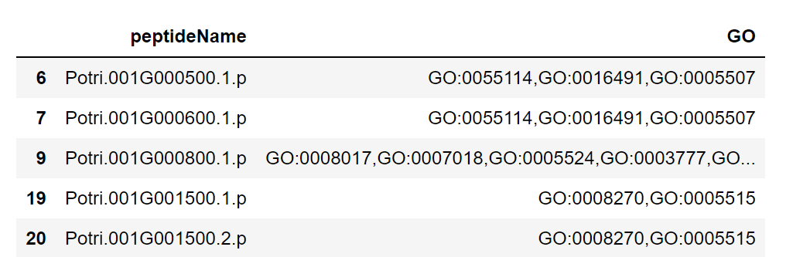
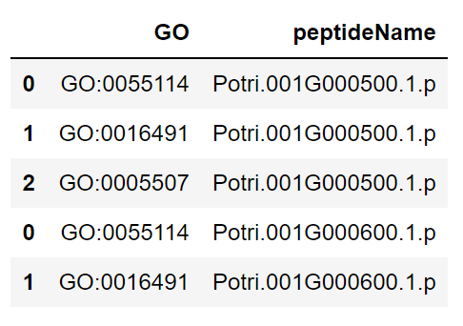
Class Exercise #3
Using the poplar annotation data frame, reduce the data frame down to just these two columns: peptideName and GO. Remove any rows that have an NaN. Note, after you get the data down to just the peptideName and GO this is what you will see: but, we want to see this:
Hint #1: you cannot use apply or agg here, you must first split up the GO terms and somehow get those into their own rows.
Hint #2: remember the example with working hours of different countries?
Hite #3: you will need a panda function named iterrow() to cycle through each row of the data frame.

Slide 47
Class Exercise #3
Solution
# Create a new empty list to store our data frames
go_dfs = []
# Iterate through each row, split the GO term and make a new
# data frame for each row. Store these in our go_dfs list.
for index, row in go_annots.iterrows():
terms = row.GO.split(',')
protein = np.repeat(row.peptideName, len(terms))
df = pd.DataFrame({'peptideName': protein, 'GO': terms})
go_dfs.append(df)
# Now concatenate our dataframes we have stored in our list.
# We want to concatenate by rows:
poplar_go = pd.concat(go_dfs)
poplar_go.head()

Slide 48
Class Exercises #4
Use the new data frames from exercise 3 and the dataset from exercise 2, create a new data frame that contains these columns: peptideName, GO, Definition. We only want to keep proteins that have both a GO term definition and a protein (i.e. inner join)

Slide 49
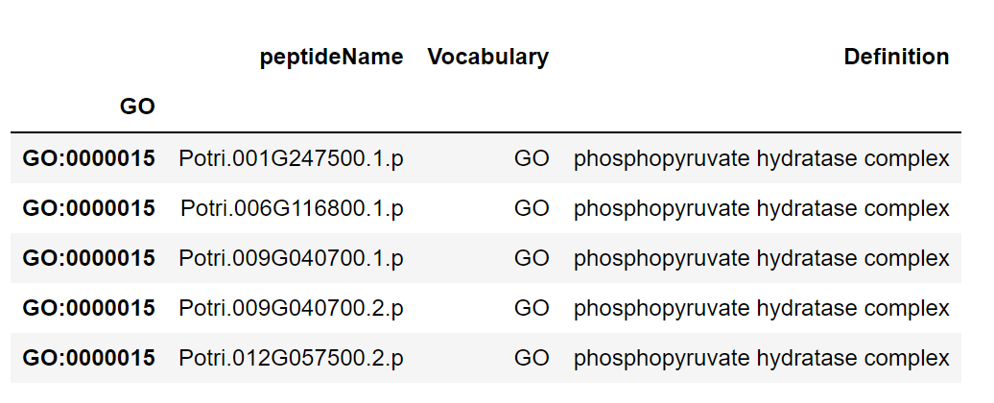
Class Exercises #4
Use the new data frames from exercise 3 and the dataset from exercise 2, create a new data frame that contains these columns: peptideName, GO, Definition. We only want to keep proteins that have both a GO term definition and a protein (i.e. inner join)
Solution:
pgo = poplar_go.set_index('GO').join(go.set_index('GO'), how='inner’)
pgo.head()

Slide 50
Assignment #8 Overview
Assignment Topic: Data cleaning and wrangling
Due Monday at 9am on Feb 26th

